Slide 1
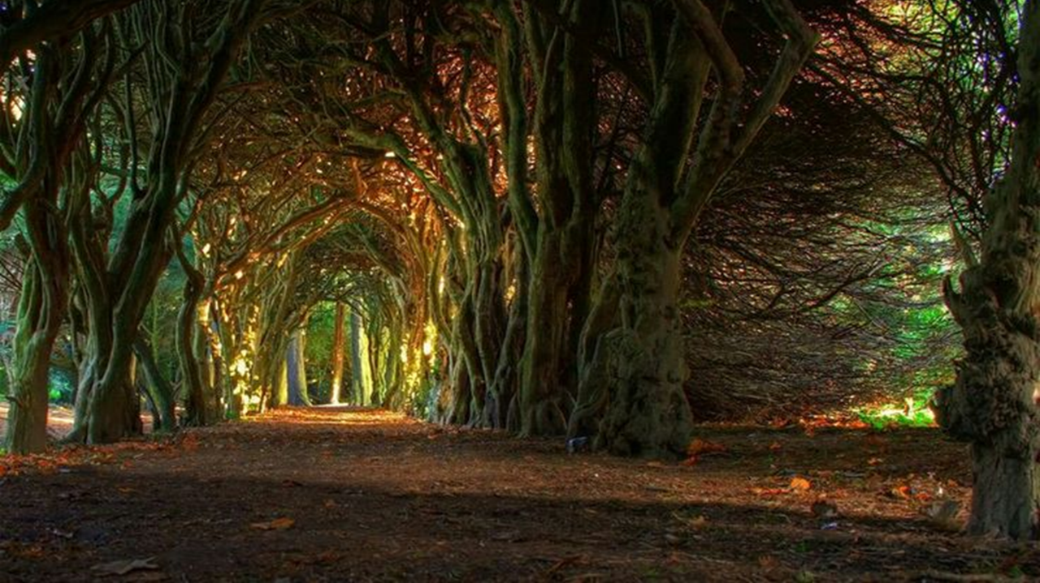
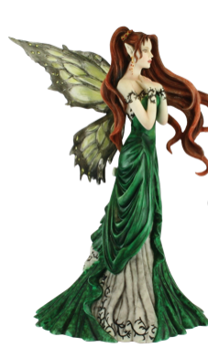



Irish Fairy Folklore
Aisling Nolan
English For Teachers

Slide 2
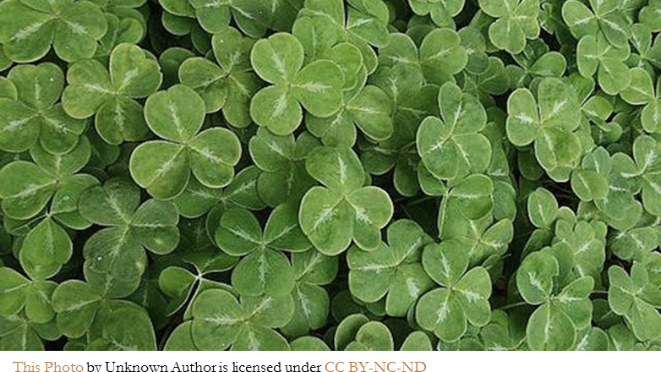

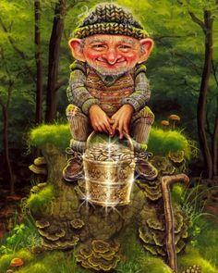
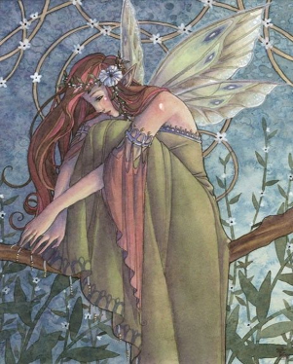
Leprechaun
/le-pre-kawn/
The Leprechaun is a type of fairy in Irish folklore.

Slide 3
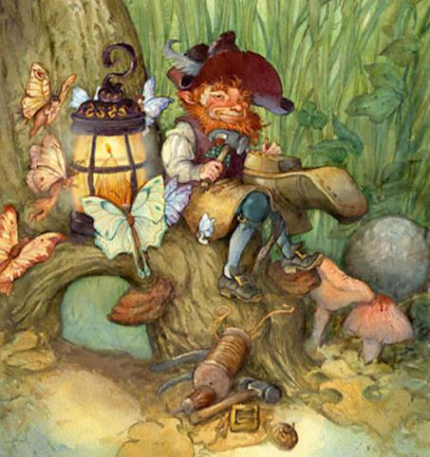
They are usually represented as little bearded men, wearing a coat and hat, who are often mischievous (i.e. badly behaved/naughty).
They are solitary creatures who spend their time making and repairing shoes. The leprechaun is a shoemaker, and he provides the fairies with their dancing shoes. As the fairies love to dance, he is always busy.

Slide 4
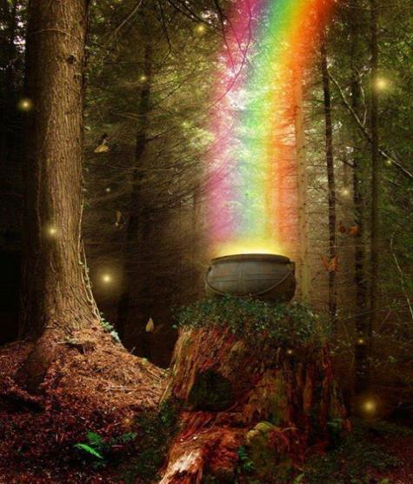
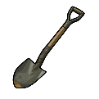

They have a hidden pot of gold at the end of the rainbow.
If caught by a human, they often grant three wishes in exchange for their freedom, but be very careful as leprechauns are very tricky and will misinterpret (change the meaning of) your words!
Example: a man got a leprechaun to show him the tree in the field where his treasure was located. He had no spade [shovel], so the man marked the tree with one of his red ribbons, then kindly released the leprechaun and went to get a spade. When he returned he found that every tree in the field had a red ribbon!

Slide 5

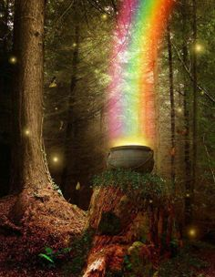
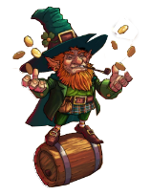
If you Caught a Leprechaun, What 3 Wishes Would you make?
If I + (verb in simple past) …, I would (do) ….
“If I caught a leprechaun, I would wish for a car”
I would wish to win the lottery”
I would wish …”
Today I catch, yesterday I caught

Slide 6
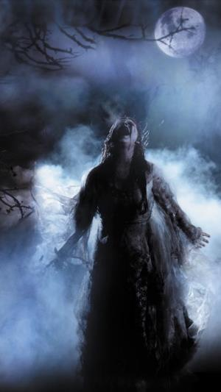
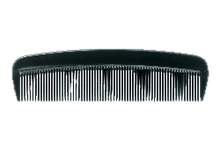
Banshee
The banshee is a fairy in Irish folklore whose scream or wail was an omen/sign of death.
She can appear in a variety of forms from a woman with long, red hair and very pale skin to an older woman with dry, grey hair, rotten teeth and fiery red eyes.
She is often represented with a comb in her hair and this has led to an Irish superstition that finding a comb on the ground is considered bad luck.

Slide 7
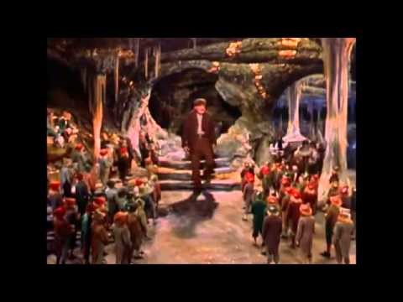
Darby O’Gill and the Little People

Slide 8
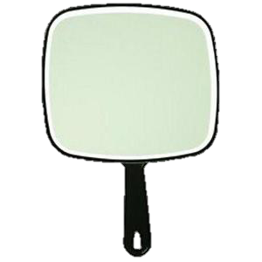
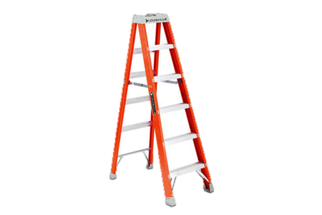

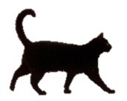

Superstitions
If you find a comb, someone in your family will die.
If you (present verb) …, you will + (present verb) …
If you open an umbrella inside, you will have bad luck.
If you keep a rabbit’s foot, you will have good luck.
If you break a mirror, you will have seven years bad luck!
If you walk under a ladder, you will have bad luck.
If you cross your fingers, it will bring good luck. – “fingers crossed”
If a black cat crosses your path, you will have bad luck.
If you put new shoes on the table, you will have bad luck.
What are some superstitions in your country for good luck and bad luck?

Slide 9
FINAL PRESENTATIONS:
3 or 4 people per team
Teams present 3 slides * each team member must speak!
Have team members from different countries – 2 or more nationalities
Slide 1: What you have learned, Slide 2: Pictures etc, Slide 3: Create a task for your students that refers to the picture(s) from Slide 2
Focus on the content first, technology second
Don’t worry, it’ll be grand!

