Slide 1
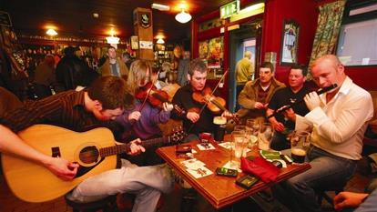



Irish Music
Aisling Nolan
English for Teachers

Slide 2
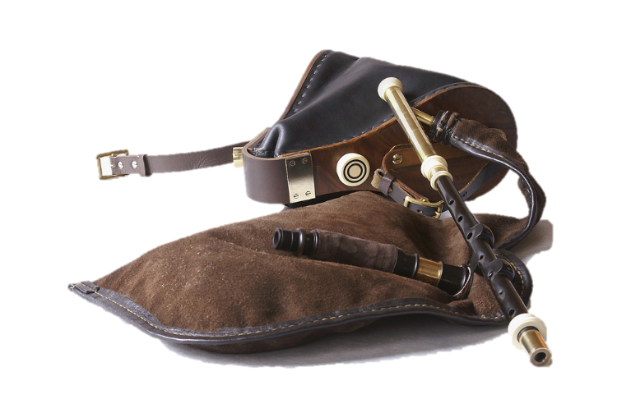
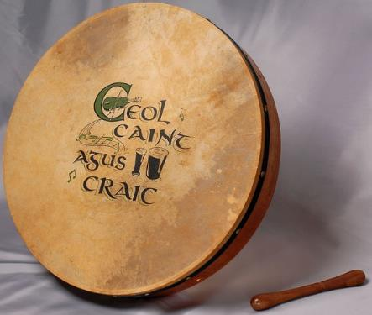
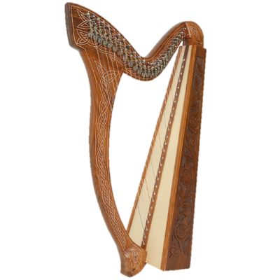
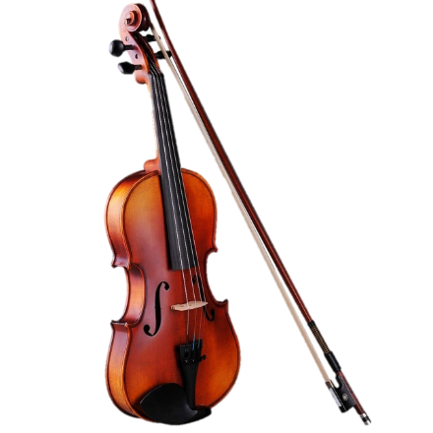
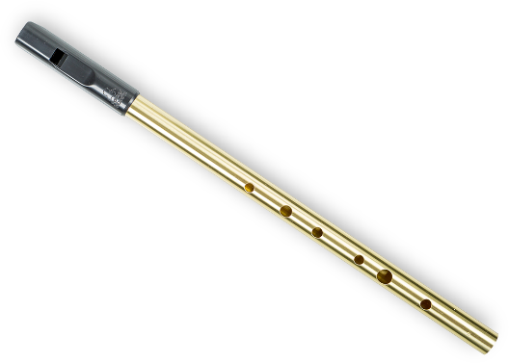
Traditional Irish Music Instruments
Celtic Harp
Bodhran
(/bow-rawn/)
Irish Bagpipes (Uilleann pipes)
Fiddle
Tin Whistle

Slide 3

The Bodhran in Action
https://www.youtube.com/watch?v=0QdbeM2JWYE

Slide 4
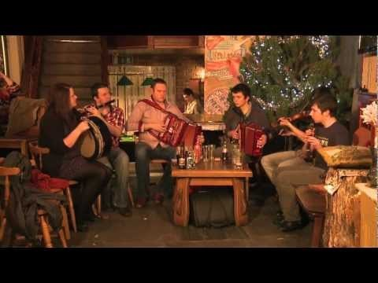
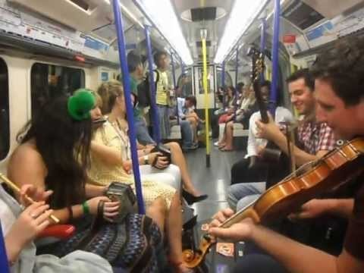
Traditional Irish Music
Also called “Trad” music.
Session – when a group of people play “Trad” music – a Trad session, usually at a party or in the pub… but it can happen ANYWHERE!

Slide 5
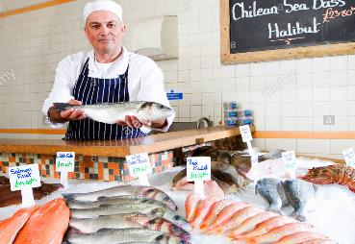

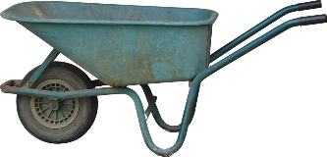

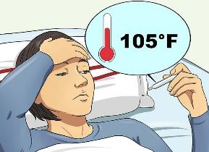
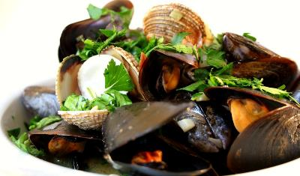
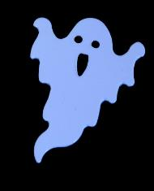
r
“In Dublin’s fair city…”
Fair: pleasant, nice, lovely
Pretty:
beautiful, attractive
Wheelbarrow:
Broad:
Narrow:
Cockles and mussels:
(shellfish)
Fishmonger:
Died (dead):
Fever:
Ghost:

Slide 6
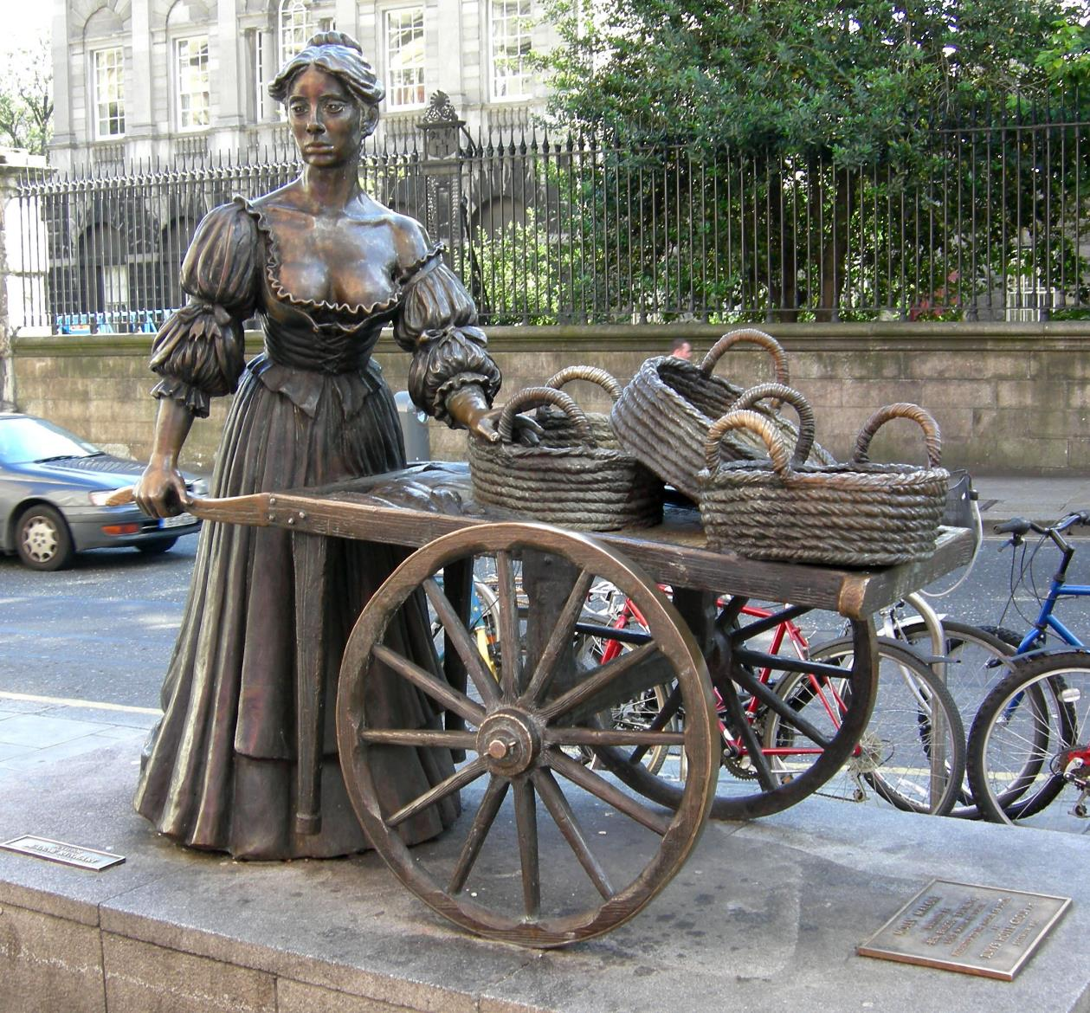
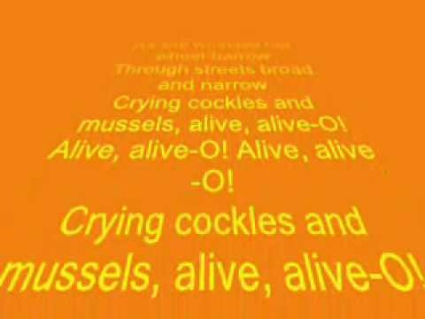

Slide 7
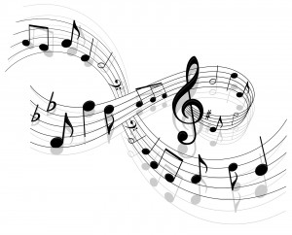
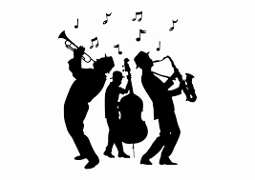
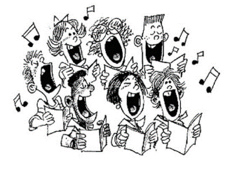
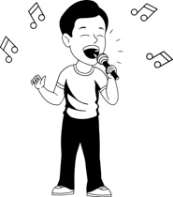
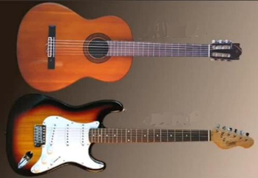
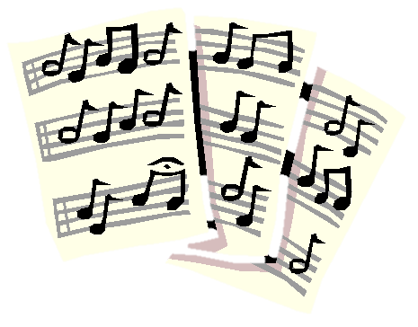
Music Vocabulary
Beat/Rhythm - - speed & pattern of musical notes
Melody – tune – What’s the tune to “Happy Birthday to you”?
Song
Lyrics - words
Solo (solo-singer)
Band,
Choir (/kwai-er/)
Male/female voice
Pitch: high/low, flat note, out of tune,
Harmony
Acoustic
Electric
Chords
Introduction
Verse
Chorus

Slide 8
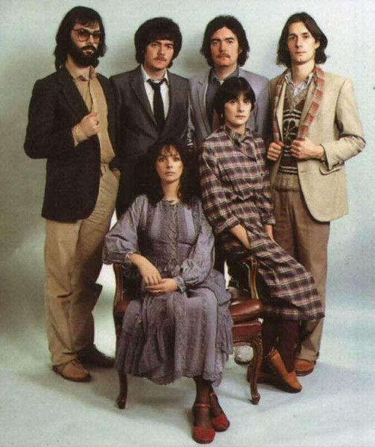
Clannad
https://www.youtube.com/playlist?list=PLCzg47isJDOzLUWF6rNlGy2rmDaT3oCWU

Slide 9




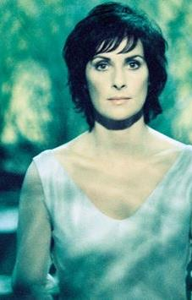
Enya

Slide 10
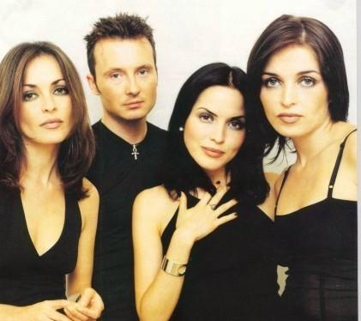
The Corrs

Slide 11
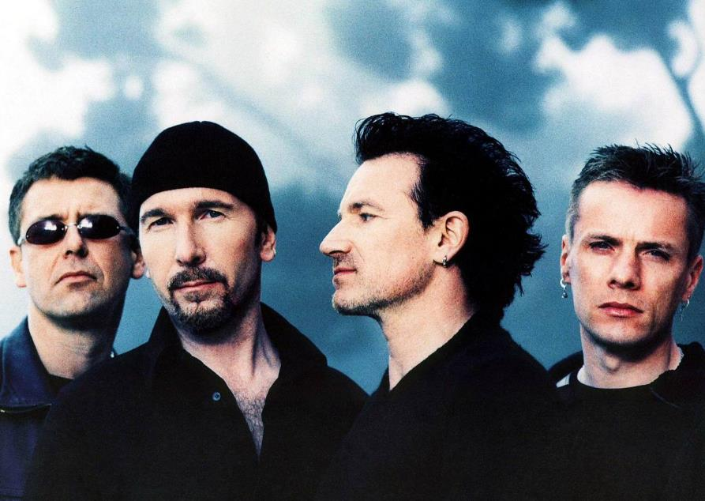
U2

Slide 12
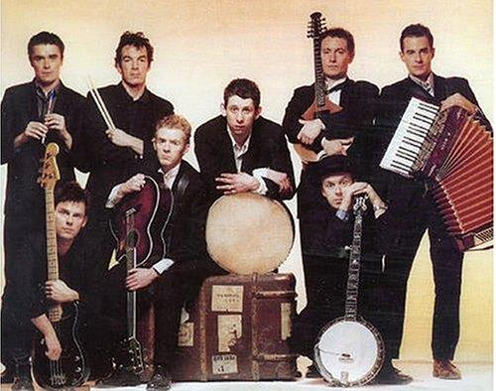
The Pogues

Slide 13
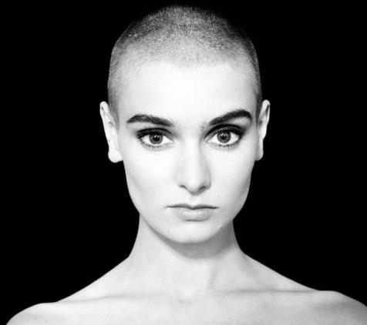
Sinead O’Connor

Slide 14
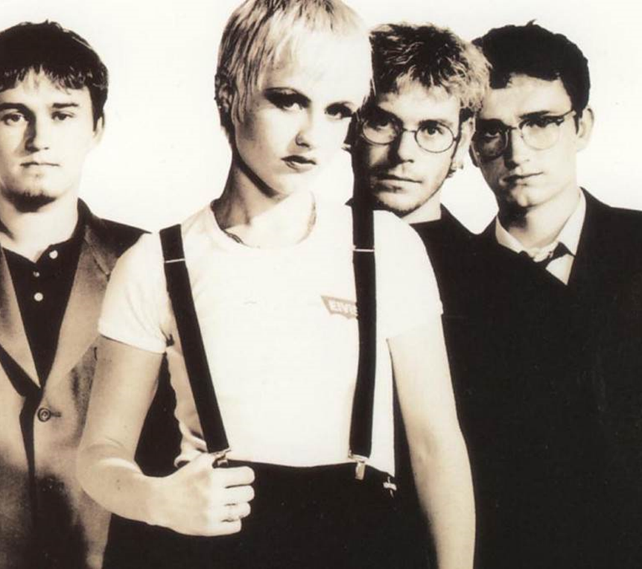
The Cranberries

Slide 15
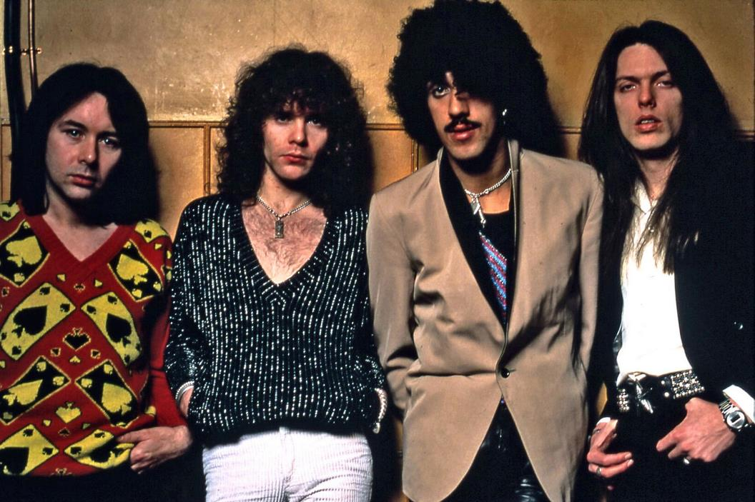
Thin Lizzy

Slide 16
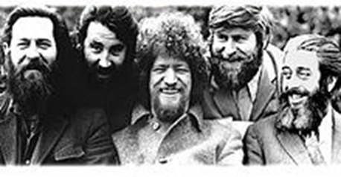
The Dubliners

Slide 17
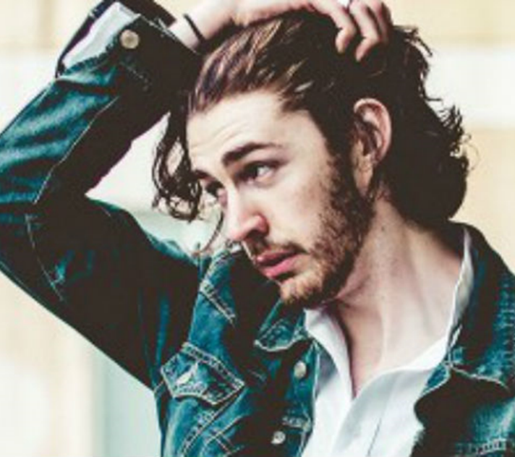
Hozier

Slide 18
What genre of music?
Pop - Popular music
Rock
Country
Traditional “Trad”/folk
Classical
Easy listening
Soul
Jazz
Traditional/Contemporary/crossover
Q: What genre(s) of music do you like to listen to?
A: I like to listen to….
ECLECTIC – I have an eclectic taste in music

Slide 19
What was the first concert you went to?
Include:
How old were you?
Who were you with?
Where was it?
How was it?
…
Example:
The first concert I went to was (name)/My first concert was (name) at the (venue) in (location).
I was___ years old. I went with _________. It was_________.....

Slide 20
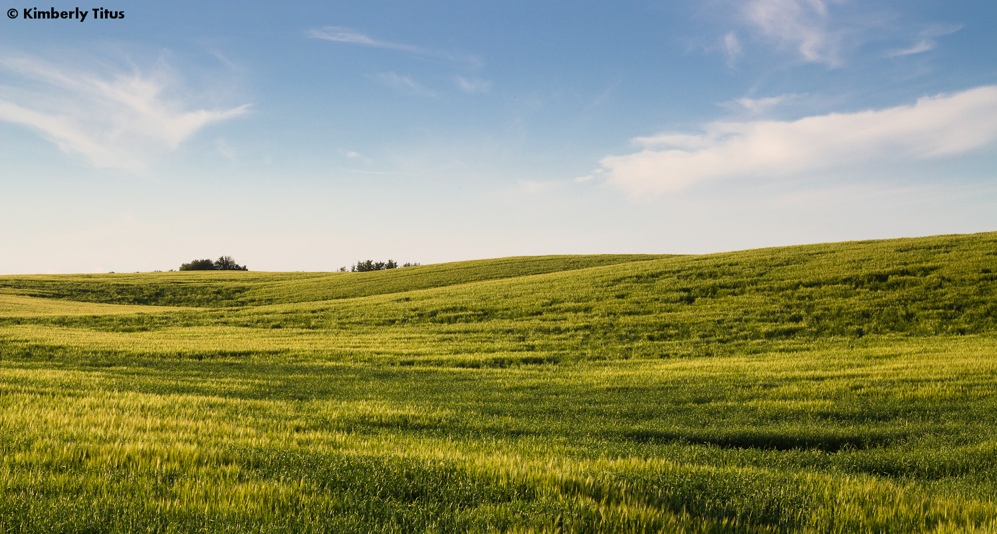
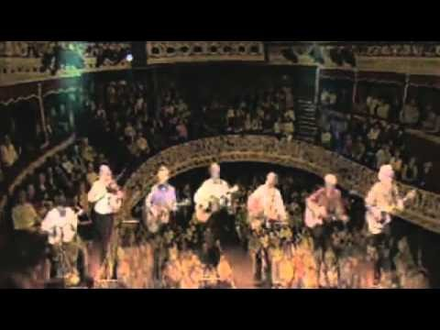

The Dubliners The Fields Of Athenry
By a lonely prison wall
I heard a young girl calling
Michael they have taken you away
For you stole Trevelyan’s corn
So the young might see the morn
Now a prison ship is waiting in the bay
Chorus
Low lie the fields of Athenry
Where once we watched the small free birds fly
Our love was on the wing
We had dreams and songs to sing
Now it's lonely round the fields of Athenry
By a lonely prison wall
I heard a young man calling
Nothing matters Mary when you're free
Against the famine and the crown
I rebelled they cut me down
Now you must raise our child with dignity
By a lonely harbour wall
She watched the last star falling
As the prison ship sailed out against the sky
Now she must live in hope and pray
For her love in Botany Bay
It’s so lonely round the fields of Athenry
Sir Charles Trevelyan: English civil servant, his bad policies contributed to the Irish potato famine/genocide.
Corn:
Athenry: town in County Galway
Botany Bay: the place where ships arrived in Sydney, Australia

Slide 21
FINAL PRESENTATIONS:
3 or 4 people per team
Teams present 3 slides * each team member must speak!
Have team members from different countries – 2 or more nationalities
Slide 1: What you have learned, Slide 2: Pictures etc, Slide 3: Create a task for your students that refers to the picture(s) from Slide 2
Focus on the content first, technology second
Don’t worry, it’ll be grand!

Slide 22
Have you ever…?
I have/ I haven’t…
Climbed (climb)
Run (run)
Crawled (crawl)
Scaled (scale)
Found (find)
Kissed (kiss)
Felt (feel)
Spoke(n) (speak)
Held (hold)
Lips
Fingertips
Tongue
Hand
Bleed
Burn/burning/burned
Healing – heal – to make healthy
Angel/devil
Mountains
Fields

Slide 23
https://youtu.be/e3-5YC_oHjE
Present Perfect Tense: Form
The present perfect tense always has two parts: have or
has and the past participle ("third form") of the verb:
I have been / done / gone / seen, etc.

